Slide 1
Digital Design & Computer Arch. Lecture 25: Epilogue
Prof. Onur Mutlu
ETH Zürich
Spring 2020
29 May 2020

Slide 2
No Required Readings
(for this lecture)

Slide 3
Recall: Major High-Level Goals of This Course
In Digital Circuits & Computer Architecture
Understand the basics
Understand the principles (of design)
Understand the precedents
Based on such understanding:
learn how a modern computer works underneath
evaluate tradeoffs of different designs and ideas
implement a principled design (a simple microprocessor)
learn to systematically debug increasingly complex systems
Hopefully enable you to develop novel, out-of-the-box designs
The focus is on basics, principles, precedents, and how to use them to create/implement good designs

Slide 4
Recall: Why These Goals?
Because you are here for a Computer Science degree
Regardless of your future direction, learning the principles of digital design & computer architecture will be useful to
design better hardware
design better software
design better systems
make better tradeoffs in design
understand why computers behave the way they do
solve problems better
think “in parallel”
think critically
…

Slide 5
We Have Come A Long Way
Started from Transistor as the Building Block
Logic Design
ISA and Microarchitecture
Key Execution Paradigms
The Memory System
Built up to System Software Mechanisms
Takeaway 1: All we covered is real and used in real systems → increasingly important
Takeaway 2: Principles we covered apply broadly
Takeaway 3: Tradeoff analysis and critical thinking that you are exposed to apply even more broadly

Slide 6
The Transformation Hierarchy
Problem
Algorithm
Program/Language
System Software
Computer Architecture (expanded view)
SW/HW Interface
Computer Architecture (narrow view)
Micro-architecture
Logic
Devices
Electrons

Slide 7
The Best Way to Approach This Course
Take it as a learning and growth experience… all of it
What we saw changed the world & endured the test of time…
And, it will be more important…
You may not all be future architects, but…
your development and thinking can greatly benefit from the concepts, tradeoffs, principles, critical thinking…
Focus on understanding, learning, critical analysis
→ these are the agents for your growth
→ the course is designed to activate these agents

Slide 8
What We Did Not Cover

Slide 9
Computer Architecture is Very Rich
Many ideas, much creativity, many tradeoffs and problems
As scaling, performance, energy, reliability, security issues become worse in circuits and in software, computer architecture will be more and more important
Already obvious in
AI/ML accelerators
Hardware security issues
Novel execution paradigms: Processing in memory
…
See my ETH inaugural lecture
https://www.youtube.com/watch?v=kgiZlSOcGFM

Slide 10
Recall from Lecture 2: Some Takeaways
It is an exciting time to be understanding and designing computing platforms
Many challenging and exciting problems in platform design
That noone has tackled (or thought about) before
That can have huge impact on the world’s future
Driven by huge hunger for data and its analysis (“Big Data”), new applications, ever-greater realism, …
We can easily collect more data than we can analyze/understand
Driven by significant difficulties in keeping up with that hunger at the technology layer
Three walls: Energy, reliability, complexity

Slide 11
State of the Art
This is a great time to be a computer architect
Circuits strained
Applications ever more demanding
Multiple possible emerging technologies
Many requirements, many systems
Many, many security, reliability issues
…
Many big innovations require computer architecture
Problem
Algorithm
Program/Language
System Software
SW/HW Interface
Micro-architecture
Logic
Devices
Electrons

Slide 12
Many Other Ideas and Topics
Prefetching
Runahead execution: Efficient latency tolerance
Emerging memory technologies
Solid state disks and storage, I/O
Interconnection networks
Many issues in multiprocessing and multithreading
Heterogeneous multiprocessors
QoS and predictable performance
Reliable architectures
Secure architectures
Programmability, portability
Better HW/SW interfaces
Reconfigurable computing
Heterogeneous CPU-GPU-FPGA-HWAcc architectures
Specialized and domain-specific architectures – genomics, medicine, health, AI/ML
Unconventional architectures – nature-inspired, quantum, molecular, …
…

Slide 13
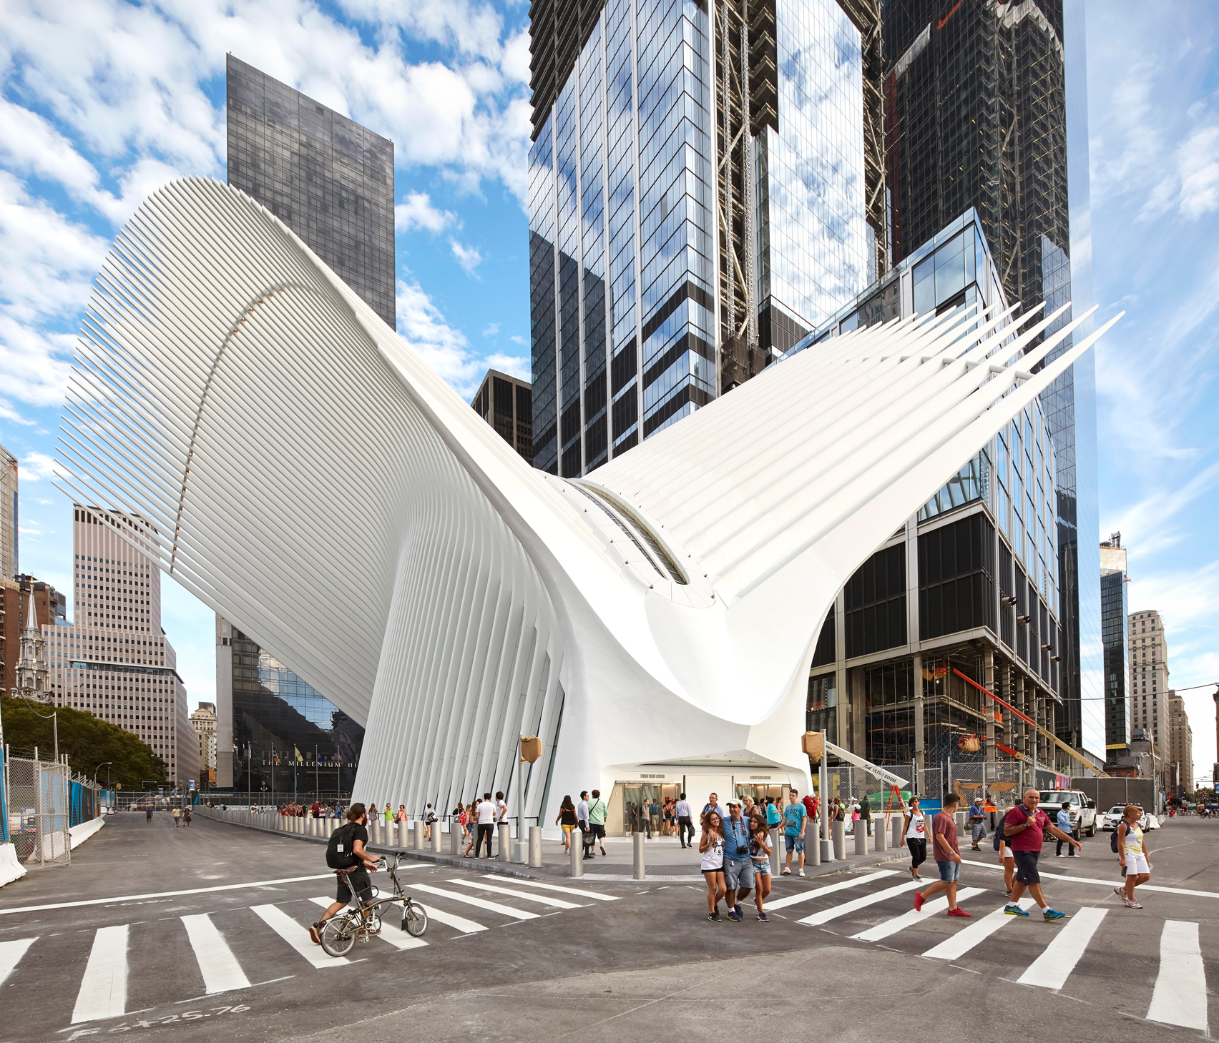
Oculus, New York City
Source: https://www.dezeen.com/2016/08/29/santiago-calatrava-oculus-world-trade-center-transportation-hub-new-york-photographs-hufton-crow/

Slide 14
Prefetching

Slide 15
Prefetching
Idea: Fetch the data before it is needed (i.e. pre-fetch) by the program
Why?
Memory latency is high. If we can prefetch accurately and early enough we can reduce/eliminate that latency.
Can eliminate compulsory cache misses
Can it eliminate all cache misses? Capacity, conflict?
Involves predicting which address will be needed in the future
Works if programs have predictable miss address patterns

Slide 16
Prefetching: The Four Questions
What
What addresses to prefetch
When
When to initiate a prefetch request
Where
Where to place the prefetched data
How
Software, hardware, execution-based, cooperative, …

Slide 17
Outline of Prefetching Issues…
Why prefetch? Why could/does it work?
The four questions
What (to prefetch), when, where, how
Software prefetching
Hardware prefetching algorithms
Execution-based prefetching
Prefetching performance
Coverage, accuracy, timeliness
Bandwidth consumption, cache pollution
Prefetcher throttling
Issues in multi-core
Prefetching in new execution paradigms

Slide 18
Runahead Execution

Slide 19
Runahead Execution Example
Perfect Caches:
Load 1 Hit
Load 2 Hit
Compute
Compute
Small OoO Instruction Window:
Load 1 Miss
Load 2 Miss
Compute
Stall
Compute
Stall
Miss 1
Miss 2
Runahead:
Load 1 Miss
Load 2 Miss
Load 1 Hit
Load 2 Hit
Compute
Runahead
Compute
Saved Cycles
Miss 1
Miss 2

Slide 20
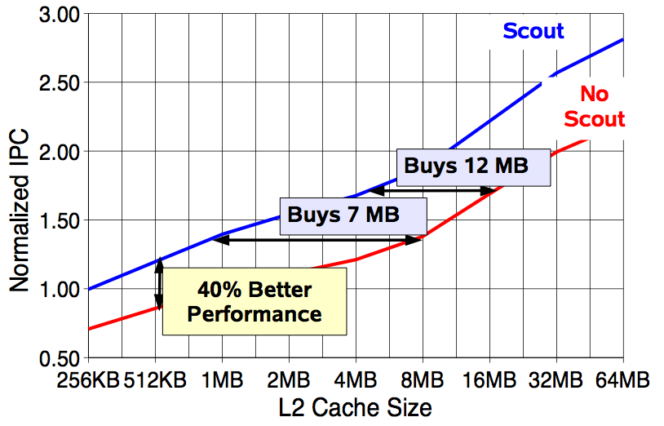
Effect of Runahead in Sun ROCK
Shailender Chaudhry talk, Aug 2008.

Slide 21
More on Runahead Execution
Onur Mutlu, Jared Stark, Chris Wilkerson, and Yale N. Patt, "Runahead Execution: An Alternative to Very Large Instruction Windows for Out-of-order Processors" Proceedings of the 9th International Symposium on High-Performance Computer Architecture (HPCA), pages 129-140, Anaheim, CA, February 2003. Slides (pdf)

Slide 22
More on Runahead Execution (Short)
Onur Mutlu, Jared Stark, Chris Wilkerson, and Yale N. Patt, "Runahead Execution: An Effective Alternative to Large Instruction Windows" IEEE Micro, Special Issue: Micro's Top Picks from Microarchitecture Conferences (MICRO TOP PICKS), Vol. 23, No. 6, pages 20-25, November/December 2003.

Slide 23
Runahead Readings
Required
Mutlu et al., “Runahead Execution”, HPCA 2003, Top Picks 2003.
Recommended
Mutlu et al., “Efficient Runahead Execution: Power-Efficient Memory Latency Tolerance,” ISCA 2005, IEEE Micro Top Picks 2006.
Mutlu et al., “Address-Value Delta (AVD) Prediction,” MICRO 2005.
Armstrong et al., “Wrong Path Events,” MICRO 2004.

Slide 24
If You Want More of This…

Slide 25
Multiple Future Options
Take the Bachelor’s Seminar in Comp Arch
Offered every Fall and Spring
https://safari.ethz.ch/architecture_seminar/fall2018/doku.php
Take the Computer Architecture course
Offered every Fall
https://safari.ethz.ch/architecture/fall2018/doku.php
Read the referenced papers methodically and critically
Do research with us
https://safari.ethz.ch/

Slide 26

SAFARI Research Group
Think BIG, Aim HIGH!
https://safari.ethz.ch

Slide 27
Bachelor’s Seminar in Computer Architecture
Fall 2020
2 credit units
Rigorous seminar on fundamental and cutting-edge topics in computer architecture
Critical presentation, review, and discussion of seminal works in computer architecture
We will cover many ideas & issues, analyze their tradeoffs, perform critical thinking and brainstorming
Participation, presentation, synthesis report
You can register for the course online
https://safari.ethz.ch/architecture_seminar/spring2020/doku.php

Slide 28
(Next) Computer Architecture Course
Fall 2020
8 credit units
Introduces the basic components of a modern computing system (processors, memory, interconnects, storage).
Covers the fundamental concepts of the different parts of modern computing systems.
Covers the latest trends by exploring the recent research in Industry and Academia.
Exam, lab assignments, homeworks
You can register for the course online
https://safari.ethz.ch/architecture/fall2019/doku.php
Notes:
memory technologies (including DRAM and new Non-Volatile Memory technologies), memory scheduling, parallel computing systems (including multicore processors and GPUs), heterogeneous computing, processing-in-memory, interconnection networks, etc.

Slide 29
Doing Research with Us
If you are interested in learning more and doing research in Computer Architecture, three suggestions:
Email me with your interest (CC: Juan, Mohammed, Lois, Hasan)
Take the seminar course and the “Computer Architecture” course
Do readings and assignments on your own
There are many exciting projects and research positions available, spanning:
Memory systems
Hardware security
GPUs, FPGAs, heterogeneous systems, …
New execution paradigms (e.g., in-memory computing)
Security-architecture-reliability-energy-performance interactions
Architectures for medical/health/genomics

Slide 30
Food for Thought: Two Quotes
The reasonable man adapts himself to the world;
The unreasonable one persists in trying adapt the world to himself.
Therefore all progress depends on the unreasonable man.
George Bernard Shaw
Progress is impossible without change,
and those who cannot change their minds
cannot change anything.
Image: By Alvin Langdon Coburn - Illustrated London News, p. 575 (subscription required), PD-US, https://en.wikipedia.org/w/index.php?curid=49887931

Slide 31
Digital Design & Computer Arch. Lecture 25: Epilogue
Prof. Onur Mutlu
ETH Zürich
Spring 2020
29 May 2020

Slide 32
Research & Teaching: Some Overview Talks
https://www.youtube.com/watch?v=kgiZlSOcGFM&list=PL5Q2soXY2Zi8D_5MGV6EnXEJHnV2YFBJl
Future Computing Architectures
https://www.youtube.com/watch?v=kgiZlSOcGFM&list=PL5Q2soXY2Zi8D_5MGV6EnXEJHnV2YFBJl&index=1
Enabling In-Memory Computation
https://www.youtube.com/watch?v=oHqsNbxgdzM&list=PL5Q2soXY2Zi8D_5MGV6EnXEJHnV2YFBJl&index=7
Accelerating Genome Analysis
https://www.youtube.com/watch?v=hPnSmfwu2-A&list=PL5Q2soXY2Zi8D_5MGV6EnXEJHnV2YFBJl&index=9
Rethinking Memory System Design
https://www.youtube.com/watch?v=F7xZLNMIY1E&list=PL5Q2soXY2Zi8D_5MGV6EnXEJHnV2YFBJl&index=3

Slide 33
Research in Computer Architecture

Slide 34
State of the Art
This is a great time to be a computer architect
Circuits strained
Applications ever more demanding
Multiple possible emerging technologies
Many requirements, many systems
Many, many security, reliability issues
…
Many big innovations require computer architecture
Problem
Algorithm
Program/Language
System Software
SW/HW Interface
Micro-architecture
Logic
Devices
Electrons

Slide 35
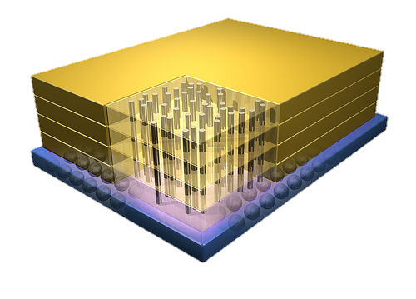


Example: Why In-Memory Computation Today?
Push from Technology
DRAM Scaling at jeopardy
→ Controllers close to DRAM
→ Industry open to new memory architectures
Pull from Systems and Applications
Data access is a major system and application bottleneck
Systems are energy limited
Data movement much more energy-hungry than computation
Dally, HiPEAC 2015

Slide 36
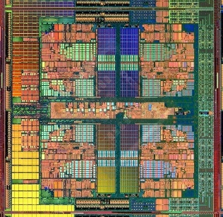
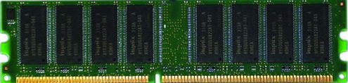
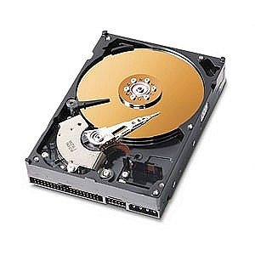
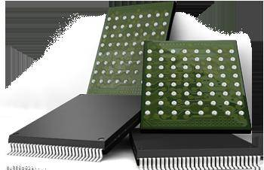
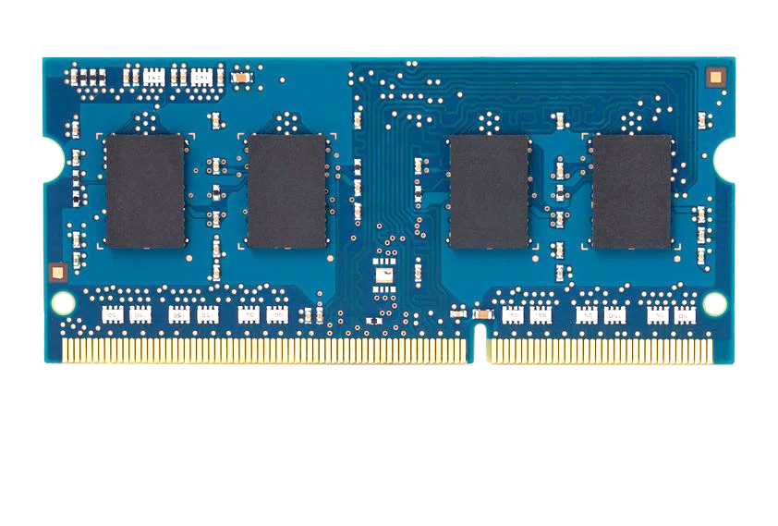
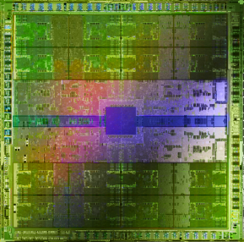
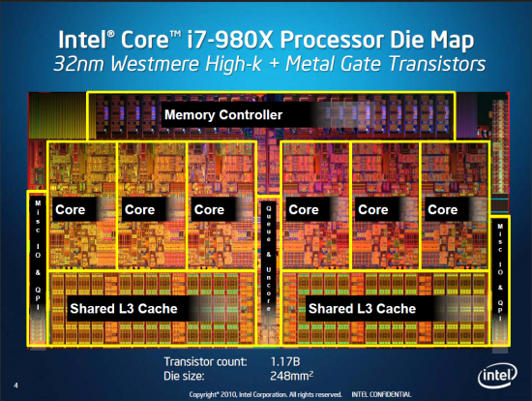
Current Research Focus Areas
Research Focus: Computer architecture, HW/SW, security, bioinformatics
Memory and storage (DRAM, flash, emerging), interconnects
Heterogeneous & parallel systems, GPUs, systems for data analytics
System/architecture interaction, new execution models, new interfaces
Energy efficiency, fault tolerance, hardware security, performance
Genome sequence analysis & assembly algorithms and architectures
Biologically inspired systems & system design for bio/medicine
Hybrid Main Memory
Heterogeneous
Processors and
Accelerators
Persistent Memory/Storage
Broad research
spanning apps, systems, logic
with architecture at the center
General Purpose GPUs
Notes:
Professor Mutlu’s research focus is all aspects of computer architecture, HW/SW interaction and bioinformatics.
He is looking for students to perform research in these areas.
He and his group, SAFARI, solve fundamental problems spanning:
Memory, memory, memory, storage, interconnects
Parallel architectures, heterogeneous architectures, GP-GPUs
System/architecture interaction, new execution models
Energy efficiency, fault tolerance, hardware security
Genome sequence analysis and assembly
His group does broad research spanning systems to logic with architecture at center

Slide 37
Four Key Current Directions
Fundamentally Secure/Reliable/Safe Architectures
Fundamentally Energy-Efficient Architectures
Memory-centric (Data-centric) Architectures
Fundamentally Low-Latency Architectures
Architectures for Genomics, Medicine, Health

Slide 38
Research Across the Stack
Problem
Algorithm
Program/Language
System Software
SW/HW Interface
Micro-architecture
Logic
Devices
Electrons

Slide 39
One Example: Processing Inside Memory
Many questions … How do we design the:
compute-capable memory & controllers?
processor chip?
software and hardware interfaces?
system software and languages?
algorithms?
Memory
Processor
Core
Database
Graphs
Media
Cache
Query
Interconnect
Problem
Results
Algorithm
Program/Language
System Software
SW/HW Interface
Micro-architecture
Logic
Devices
Electrons

Slide 40
In-Memory DNA Sequence Analysis
Jeremie S. Kim, Damla Senol Cali, Hongyi Xin, Donghyuk Lee, Saugata Ghose, Mohammed Alser, Hasan Hassan, Oguz Ergin, Can Alkan, and Onur Mutlu, "GRIM-Filter: Fast Seed Location Filtering in DNA Read Mapping Using Processing-in-Memory Technologies" to appear in BMC Genomics, 2018. to also appear in Proceedings of the 16th Asia Pacific Bioinformatics Conference (APBC), Yokohama, Japan, January 2018. arxiv.org Version (pdf)

Slide 41
New Genome Sequencing Technologies

Slide 42
Some Basics of Research

Slide 43
How To Do Research & Advanced Dev.
We will talk a lot about this in this course
Learning by example
Reading and evaluating strong and seminal papers & designs
Learning by doing
Semester-long research/design projects, masters’ projects, PhD thesis
Learning by open, critical discussions
Paper reading groups, frequent brainstorming and discussions
Design sessions
Collaborations

Slide 44
What Is The Goal of Research?
To generate new insight
that can enable what previously did not exist
Research is a hunt for insight that can eventually impact the world

Slide 45
Some Basic Advice for Good Research
Choose great problems to solve: Have great taste
Difficult
Important
High impact
Read heavily and critically
Think big (out of the box)
Do not restrain yourself to tweaks or constraints of today
Yet, think about adoption issues
Aim high
Write and present extremely well

Slide 46
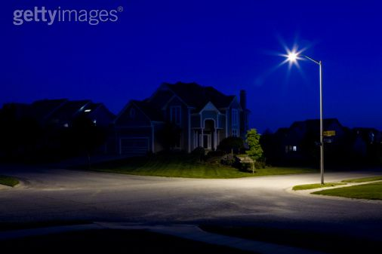
Looking here for lost keys

Slide 47
Lost keys here
Looking here

Slide 48

Current Architecture Practice

Slide 50
Aim Here
5-10 years

Slide 51
Enable this point
5-10 years

Slide 52
The Research Formula

Slide 53
Reward
If you are wildly successful, what difference will it make?

Slide 54
Effort
Learn as much as possible with as little work as possible

Slide 55
Effort
Do the minimum analysis and experimentation necessary to make a point

Slide 56
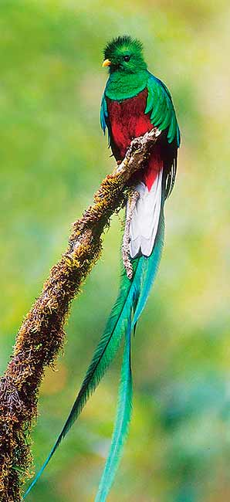
Research is a
hunt for insight
Need to get off the beaten path to find new insights

Slide 57
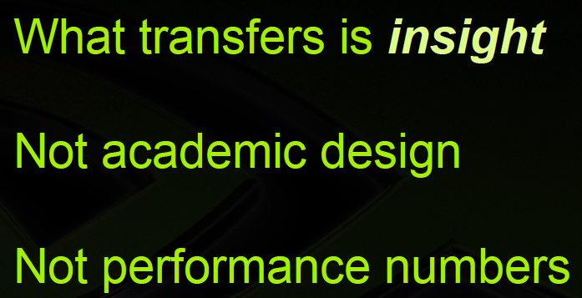

Recommended Talk
Bill Dally, Moving the needle: Effective Computer Architecture Research in Academy and Industry
ISCA 2010 Keynote Talk.
Acknowledgment: Past few slides are from this talk

Slide 58
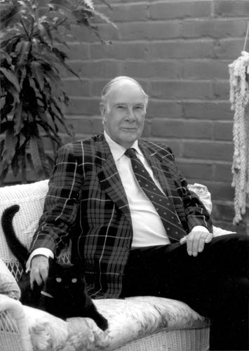
More Good Advice
“The purpose of computing is insight, not numbers”
Richard Hamming

Slide 59
Some Personal Examples

Slide 60
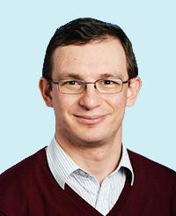
Brief Self Introduction
Onur Mutlu
Full Professor @ ETH Zurich CS, since September 2015 (officially May 2016)
Strecker Professor @ Carnegie Mellon University ECE/CS, 2009-2016, 2016-…
PhD from UT-Austin, worked at Google, VMware, Microsoft Research, Intel, AMD
https://people.inf.ethz.ch/omutlu/
omutlu@gmail.com (Best way to reach me)
https://people.inf.ethz.ch/omutlu/projects.htm
Research and Teaching in:
Computer architecture, computer systems, hardware security, bioinformatics
Memory and storage systems
Hardware security, safety, predictability; fault tolerance
Hardware/software cooperation
Architectures for bioinformatics, health, medicine
New computation, communication, storage paradigms
…

Slide 61
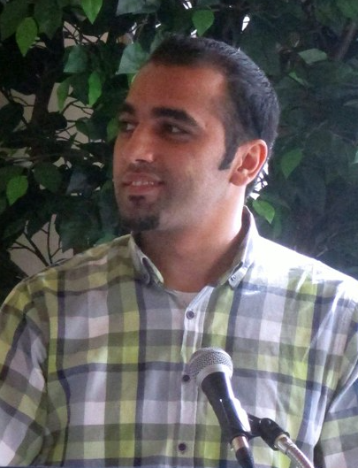
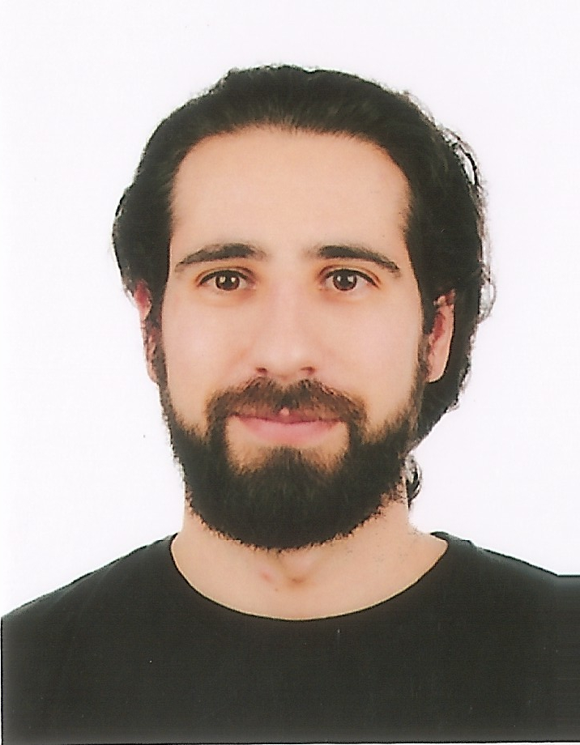
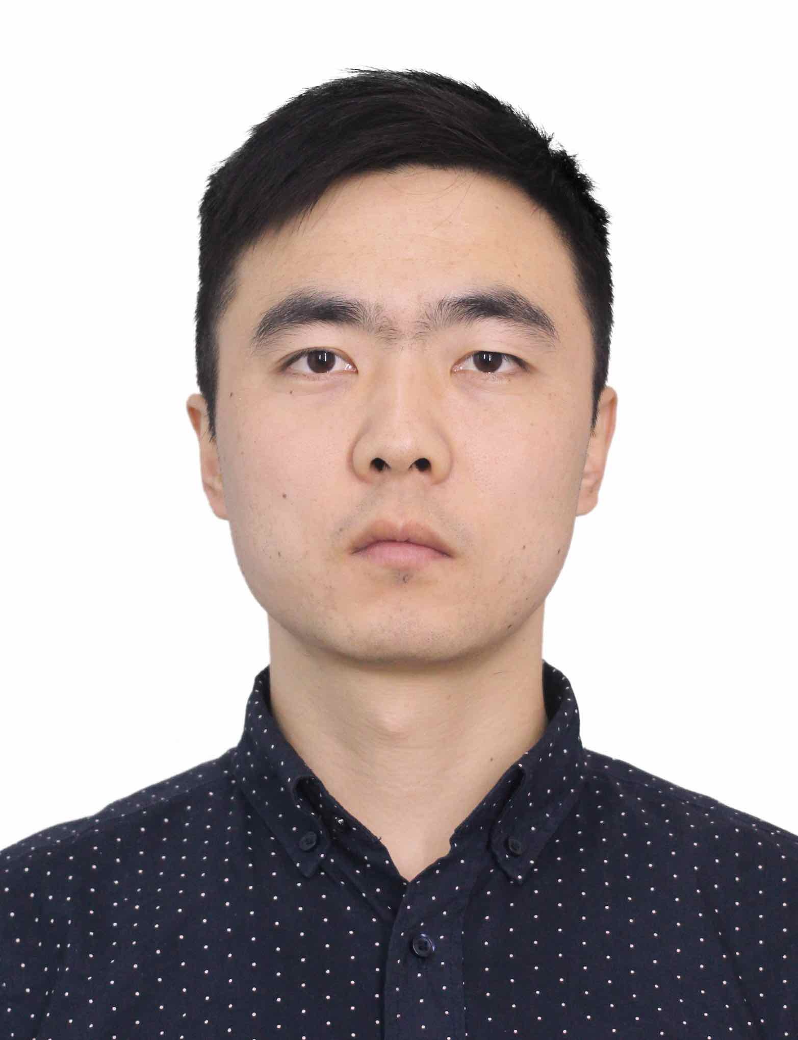
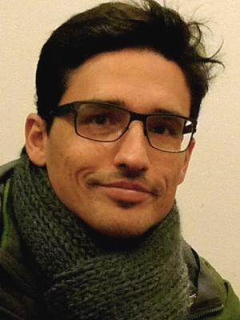
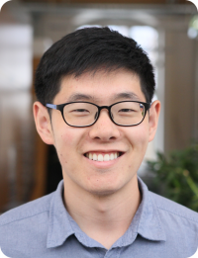
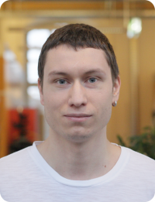
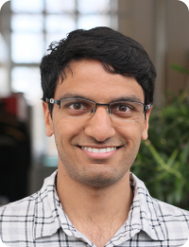
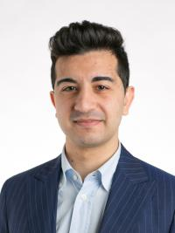
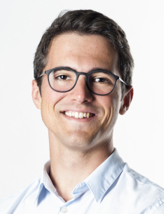
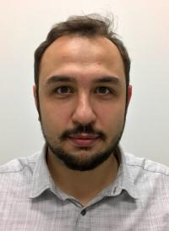
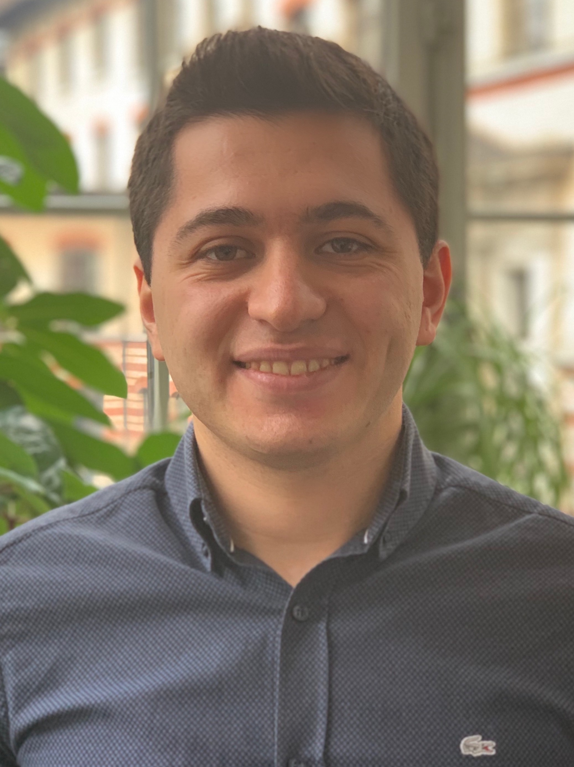
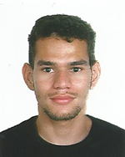
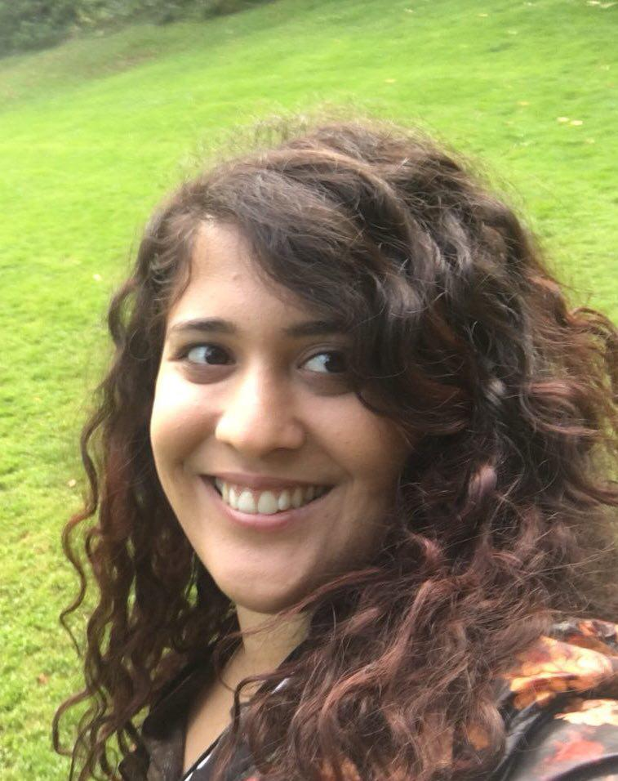
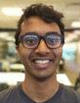
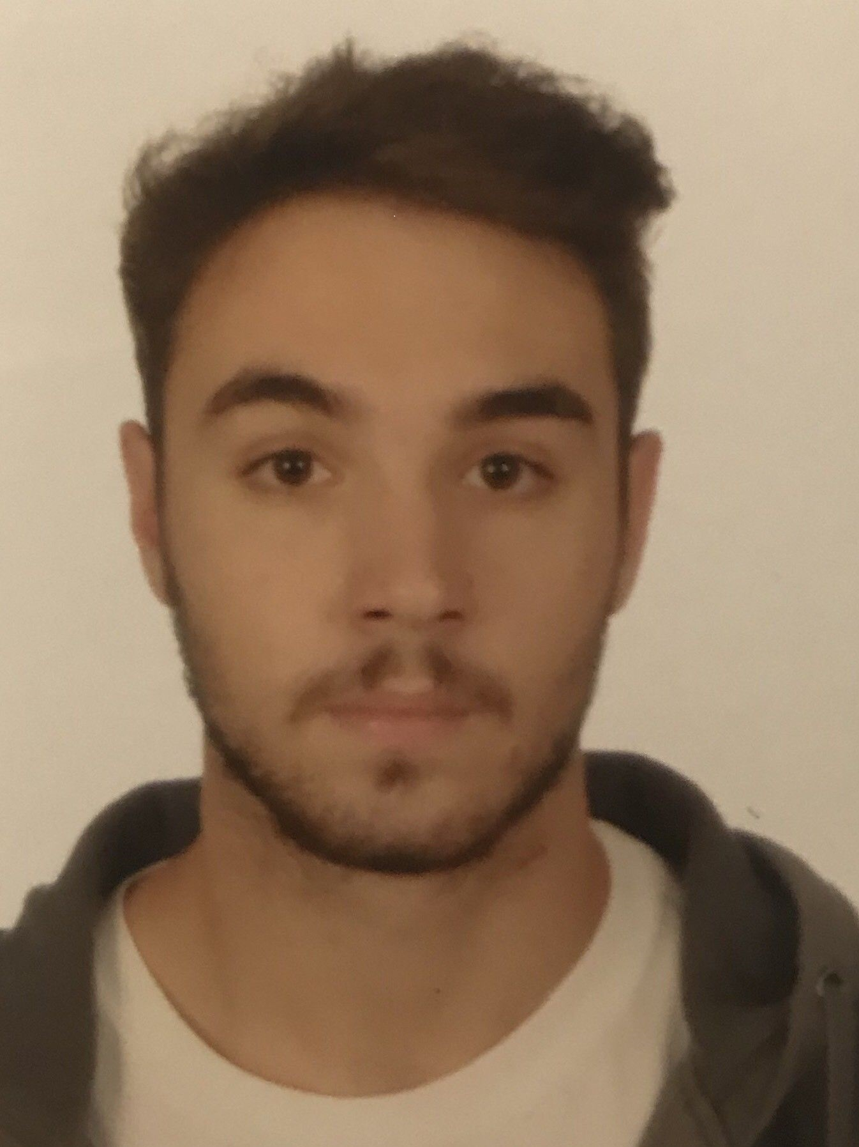
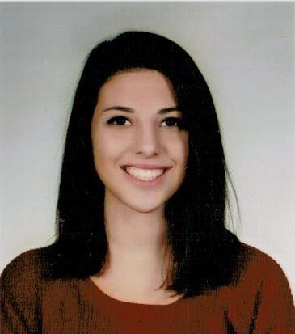
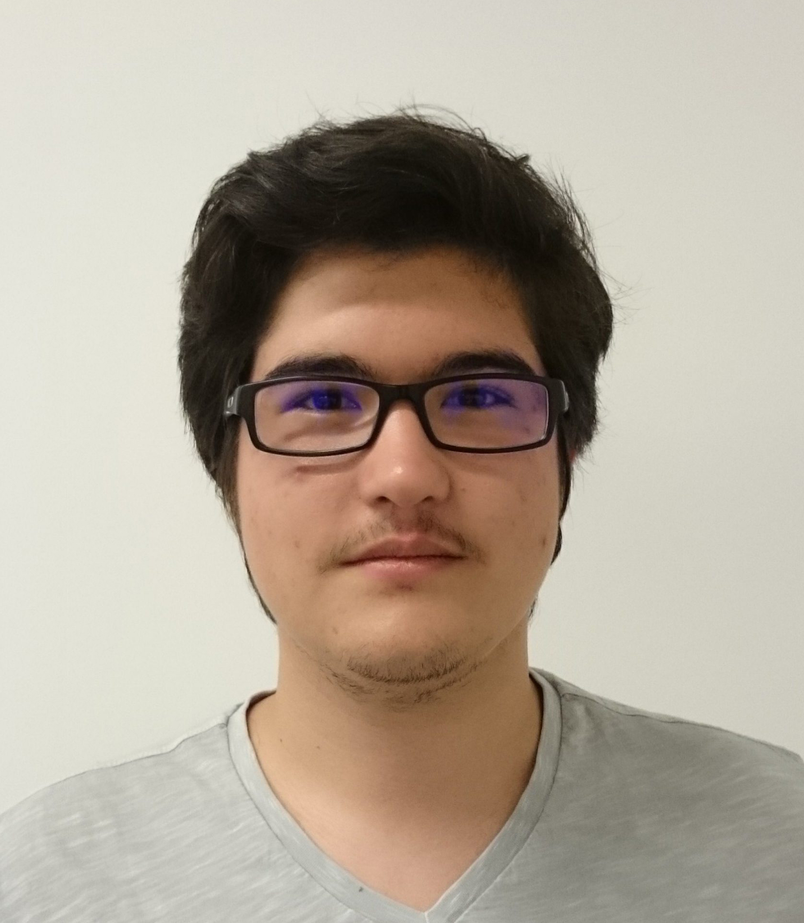
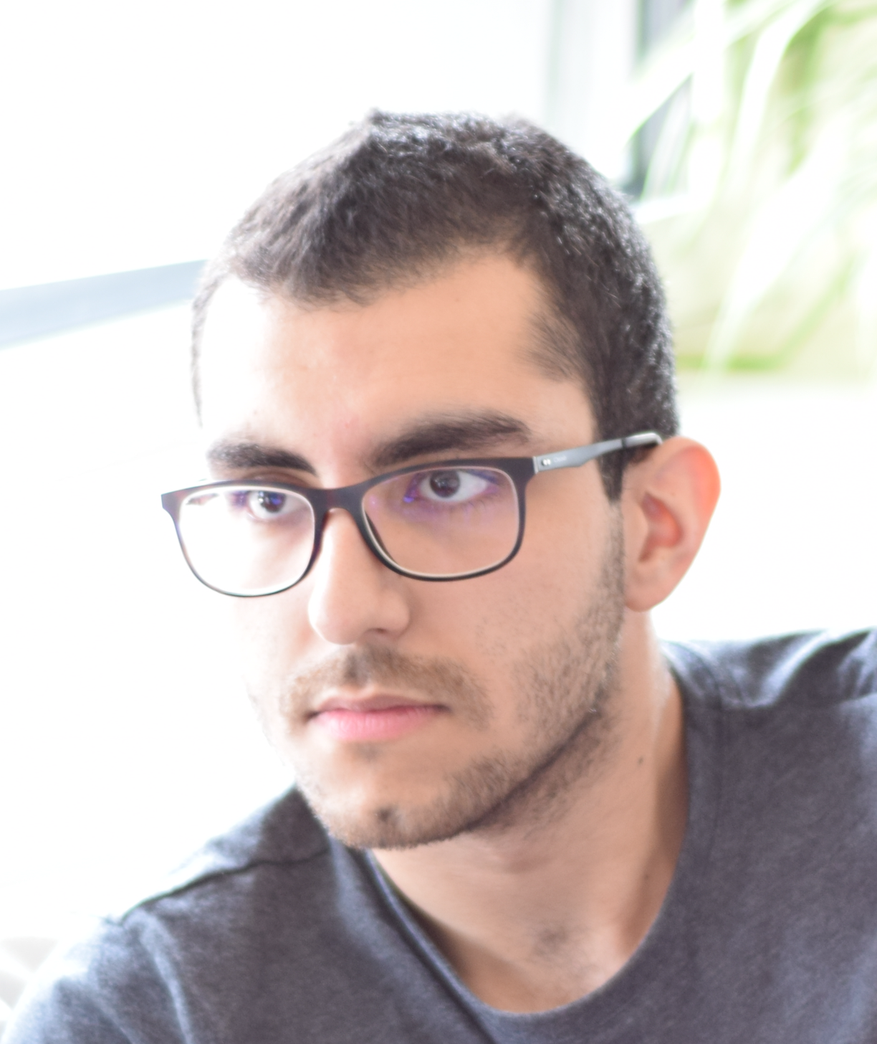
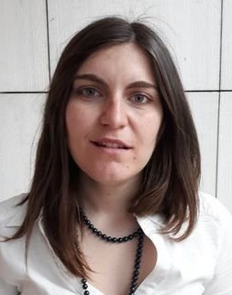
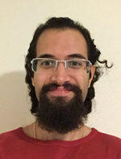
SAFARI Group Members @ ETH Zurich
4 Post-doctoral Researchers
8 PhD Students + 4 at CMU
5 Interns
15 Master’s and Bachelor’s Researchers
Dr. Mohammed Alser
Dr. Lois
Orosa
Dr. Yaohua
Wang
Dr. Juan
Gómez-Luna
Jeremie Kim
Hasan Hassan
Minesh Patel
Ivan Puddu
Lukas Breitwieser
Giray Yaglikci
Can Firtina
Geraldo F.
de Oliveira
Nika Mansouri
Skanda Koppula
Konstantinos
Kanellopoulos
Nisa Bostanci
Ataberk Olgun
Rokneddin Azizi
Christina
Giannoula
Taha
Shahroodi

Slide 62
Teaching: Accelerated Memory Course (~6.5 hours)
ACACES 2018
Memory Systems and Memory-Centric Computing Systems
Taught by Onur Mutlu July 9-13, 2018
~6.5 hours of lectures
Website for the Course including Videos, Slides, Papers
https://people.inf.ethz.ch/omutlu/acaces2018.html
https://www.youtube.com/playlist?list=PL5Q2soXY2Zi-HXxomthrpDpMJm05P6J9x
All Papers are at:
https://people.inf.ethz.ch/omutlu/projects.htm
Final lecture notes and readings (for all topics)

Slide 63
Teaching: Online Courses and Lectures
Freshman Digital Circuits and Computer Architecture Course Lecture Videos (2018, 2017)
Graduate Computer Architecture Course Lecture Videos (2018, 2017, 2015, 2013)
Undergraduate Computer Architecture Course Lecture Videos (2015, 2014, 2013)
Parallel Computer Architecture Course Materials (Lecture Videos)
https://people.inf.ethz.ch/omutlu/teaching.html
https://www.youtube.com/channel/UCIwQ8uOeRFgOEvBLYc3kc3g
https://www.youtube.com/user/cmu18447

Slide 64
Research & Teaching: Some Overview Talks
https://www.youtube.com/watch?v=kgiZlSOcGFM&list=PL5Q2soXY2Zi8D_5MGV6EnXEJHnV2YFBJl
Future Computing Architectures
https://www.youtube.com/watch?v=kgiZlSOcGFM&list=PL5Q2soXY2Zi8D_5MGV6EnXEJHnV2YFBJl&index=1
Enabling In-Memory Computation
https://www.youtube.com/watch?v=oHqsNbxgdzM&list=PL5Q2soXY2Zi8D_5MGV6EnXEJHnV2YFBJl&index=7
Accelerating Genome Analysis
https://www.youtube.com/watch?v=hPnSmfwu2-A&list=PL5Q2soXY2Zi8D_5MGV6EnXEJHnV2YFBJl&index=9
Rethinking Memory System Design
https://www.youtube.com/watch?v=F7xZLNMIY1E&list=PL5Q2soXY2Zi8D_5MGV6EnXEJHnV2YFBJl&index=3

